Slide 1
Session 1 – Area 2* Nanotechnologies and advanced materials in EeB
EeB PPP Impact workshop
Brussels, 18-19 April 2016
*) Design, decision and support tools for energy efficient buildings, districts and cities

Slide 2
Semantics-driven design for energy-efficient buildings integrated in healthcare districts

Slide 3
Scientific/Technical goals of the supported area
Main aim: 50% reduced energy use and CO₂ emission of healthcare districts in 10 years
Achievements:
Create generic semantic BIM+GIS typology models of Energy-efficient Buildings in healthcare districts
Create a framework for BEM (Building Energy Model) lifecycle model inter-connecting BIM, BAM, BOOM
Create a design decision-support tool as an interactive tool which accommodates: BIM+GIS models; KPIs for energy, life-cycle cost, fuctional quality; and stakeholder requirements

Slide 4
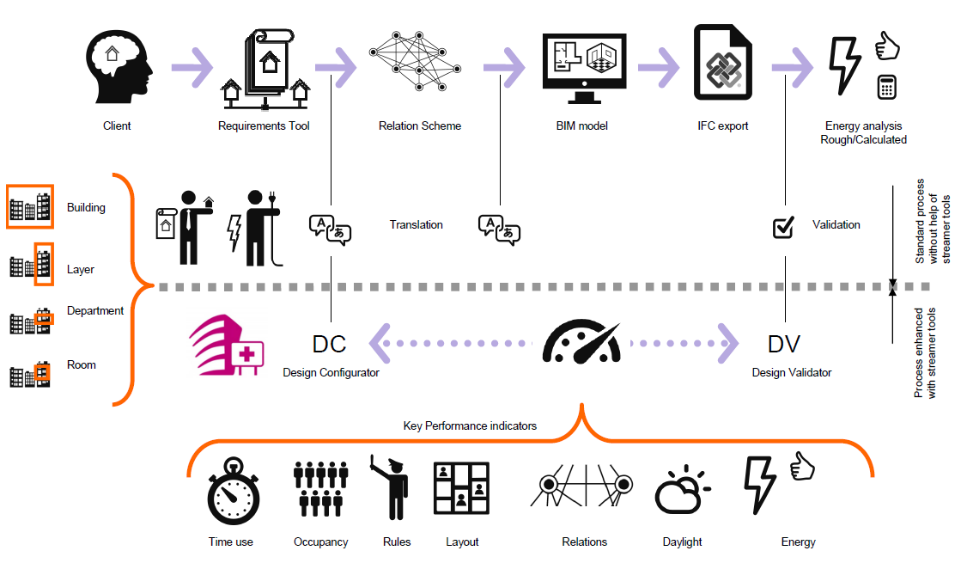
STREAMER design workflow

Slide 5
Results related to design workflow
Dashboard (decision support tool)
KPI tools (energy – quality – cost)
Design configurator – design validator
Data requirements checking
Product Lifecycle Management
Semantic labeling methodology
Design rules (rooms – MEP – façade technology)
Participatory design process

Slide 6
Current and Expected impact(s) of the supported area
Technological (e.g. based on concrete numbers provided at project level with regard to new technologies (identify the techno.), patents and standards developed as well as increase in TRL)
Economic/Social (e.g. based on information provided at project level on participation of SMEs, private investments mobilised and results taken up for further investments)
Environmental (e.g. based on information provided at project level on contribution to reduction of energy, CO2, Waste, and materials resources)
(Please provide concise information related to the KPIs in the Contractual Arrangement on your project's expected impact and limited to 2 -3 slide max./area.Link:http://ec.europa.eu/research/industrial_technologies/pdf/eeb-contractual-arrangements_en.pdf)

Slide 7
Expected technological impacts
Parametric design solutions and templates for a range of building types that can be configured and validated for each unique project.
A set of interoperable tools that enable designers and their stakeholders to gain insight in the performance of hospitals, more specifically in terms of energy usage, lifecycle costing, and quality.
Contribution to standardisation

Slide 8
Expected Economic/Social impacts
Improvements in the process of buildings design and control in order to facilitate decision-making before the construction which results in a greater ability to positively impact project costs and functions, supported by a dashboard that enables continuous evaluation of the most important KPIs.
Workforce trainings to a) foster BIM as way of working b) to raise interest in the use of STREAMER results

Slide 9
Expected Environmental impacts
up to 50% reduction of energy consumption of healthcare districts in the next 10 years, and sustainable transformation of healthcare buildings and neighborhoods in EU

Slide 10
Technical cross-cutting issues
What technical cross-cutting issues are addressed in your project that would increase the overall impact?
Interoperability (and/or standardization) of software tools (design tools, simulation tools) Interoperability of KPIs and approaches between projects (ie, a user can combine results from 2 or more projects without great engineering effort or conceptual adaptations) Strengthening or dismissing technical approaches by ‘peer review’

Slide 11
Non-technical cross-cutting issues
What non-technical cross-cutting issues are addressed in your project that would increase the overall impact?
Exploitation – including IPR issues Two ESS were held; KERs identified; ongoing discussion and definition Further development of results outside project scope For at least one result this is now explored One other result to be included in greater scheme of tools Standardization Activities have just started Involving Implementer Communities Activities have just started; aimed at review, and at creating a user base for the project results including commercial opportunities

Slide 12
Synergies and benefits of clustering
What cluster activities have you undertaken in the last year / are you planning to undertake?
Explore options for an Open EeB software platform Exchange results and insights
How have cluster activities added / would add value to your projects?
Understanding of the main drivers of energy use and viable approaches – including peer ‘review’ of approaches Pointers to relevant software and algorithms Delimiting project scope
How can cluster activities help exploitation of results after the projects end?
Combination of software results: a common repository including management and ‘marketing’ activities; possibly exploitation

Slide 13
Summary / way forward
Project goals according to plan – results identified and exploitation addressed
Exchange with cluster projects should be reinforced now that results are becoming more and more clear
Productization (exploitation strategy) is still an unknown – exchange with cluster projects could help here as well

